Slide 1
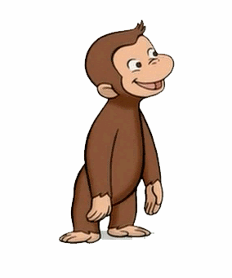
CALGARY KIOSK
MEMBERS: DANIEL, DEBBIE & JOANNA #DD&J

Slide 2
Introduction
Information kiosk for immigrants
Previous problem: Scope was too large and integrated too much functionality that would have been resolved by a separate stand alone application and what would the user be able to take away after using the kiosk
Now focused: Developing events to allow the user to become more integrated into society
Notes:
ice prototype – can totally understand the difficulty with ‘fidelity’ since it’s a matter of ‘how much information do you want to add into the prototype?’. Be sure to think about what happens at the end of the interaction – as someone is walking away from the prototype, do they have a solid sense of what their next steps are? Can you let someone capture a QR code to add an event to their calendar, or print out a list of things they’ve stared, etc.? At the moment most of your interactions are navigating between lists (which is alright for now), try to think about some possible interesting interactions beyond navigation (Weird idea I thought up which is just an example: let the user build a list of events/restaurants/locations/facts/etc. which they can get printed)

Slide 3
Feedback From horizontal Prototype
Be sure to think about what happens at the end of the interaction – as someone is walking away from the prototype, do they have a solid sense of what their next steps are?
Want them to feel smart and informed
Simple interface
Provide useful information (events)
Walk away with a printed page of the event they have chosen
Resizing of text more appropriate for a kiosk
Notes:
The main feedback that we’re always getting (horizontal and wireframe ) is: what do you want your users to feel, walking away from the kiosk?.
Some minor feedback include cosmetic issues, such as resizing of the text.
New feature that we have is print, which is basically printing off the event you have chosen.
A brief introduction to your problem area. What exact scenario are you trying to address? What feedback from your previous prototype (User Evaluationgs of Horizontal Prototype) are you trying to resolve?
A brief discussion of your most recent design rationale.
A demo of your vertical prototype.

Slide 4
User evaluation Tasks
-explore the interface
-return to homepage
-browse events by area
-find dining locations
-find city transit information
-name the actions available on the top bar from memory

Slide 5
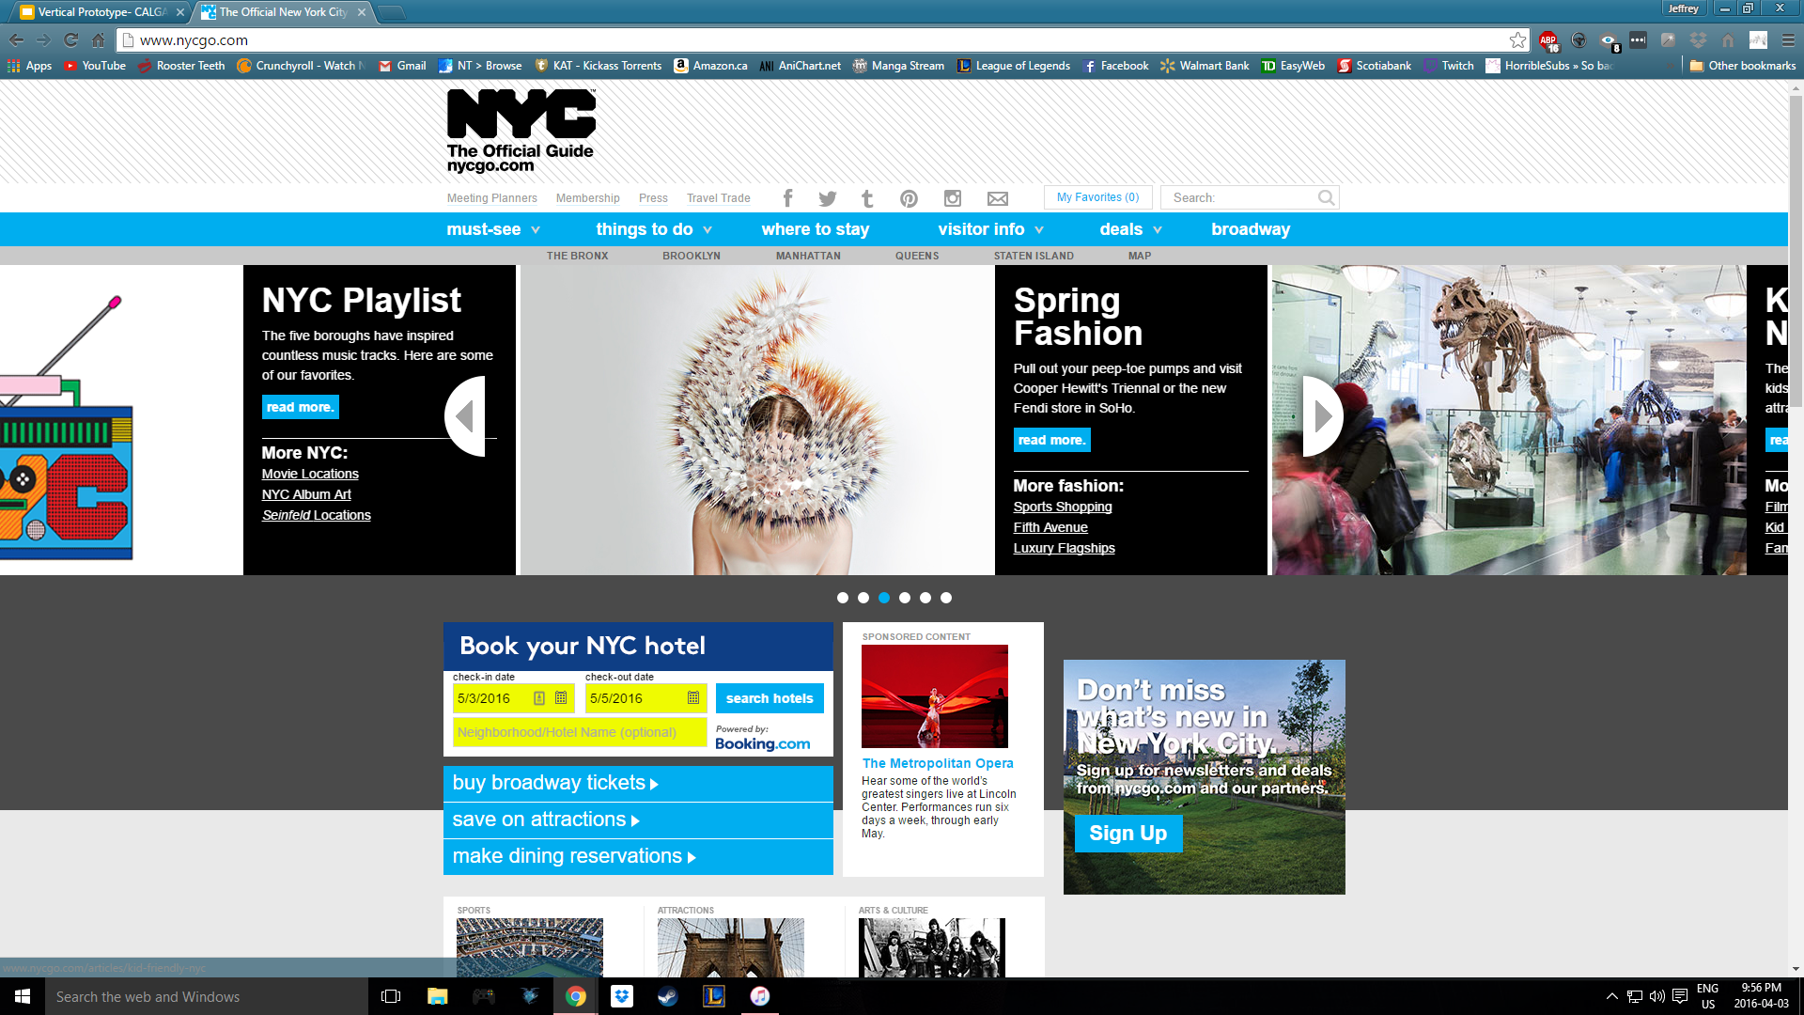
Comparing to a control
nycgo

Slide 6
User Evaluation results (Pros)
-Simple interface to navigate through quickly
-different ways of searching for events (e.g. area and culture)
-consistent interface throughout application
-not a lot of sub navigation
-easy to remember navigation through kiosk

Slide 7
User Evaluation results (Cons)
-Interface needs to be more visually pleasing
-fonts are too small for a kiosk interface
-separate link for transit isn’t logical
-needs to have a back button (error recovery)
-drop list isn’t an ideal choice for choosing locations
-links would be nice for more information about locations

Slide 8
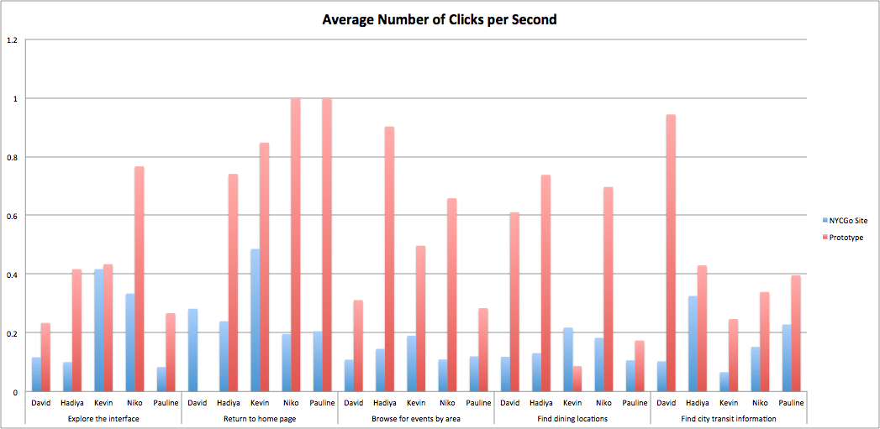

Slide 9
Changes
-Focused on socializing and events
-Added a free filter and age filter
-Area filter changed from a drop down list to a map of Calgary(regions rather than communities as selection)
-Added a page for upcoming events on main events page
-Print feature
-Clear all filters function
-Added more color and animation in application

Slide 10
scenario
AN IMMIGRANT ATHLETE IS JOGGING THROUGH A LOCAL PARK AND DISCOVERS THE KIOSK WHILE SHE TAKES A BREAK. AS SHE SEARCHES THROUGH THE FILTERS AND EVENTS AVAILABLE, SHE BECOMES MORE INTERESTED IN A FREE EVENT THAT MATCHES HER INTERESTS.

Slide 11
demo

